Slide 1
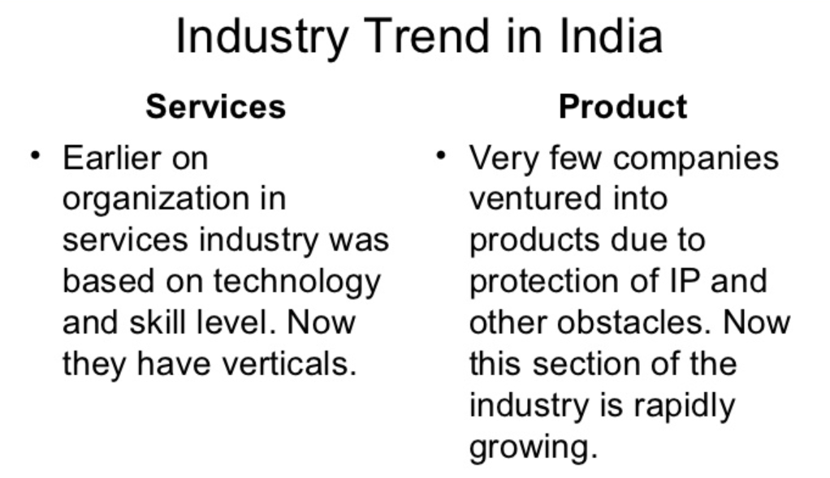


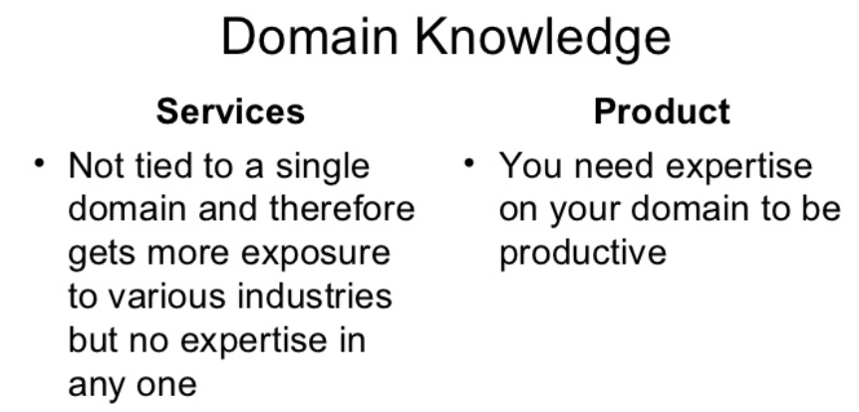
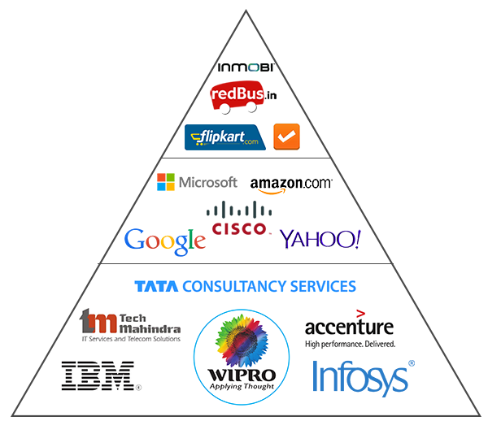
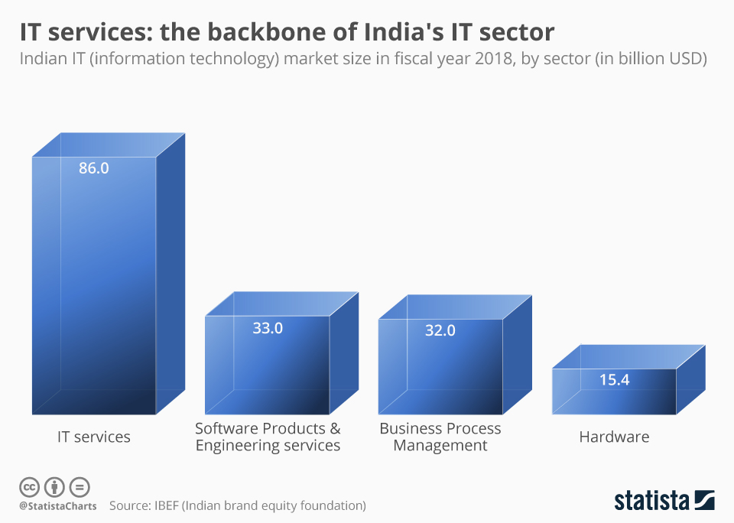
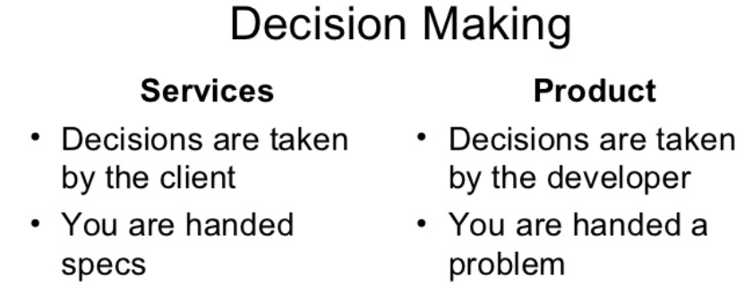
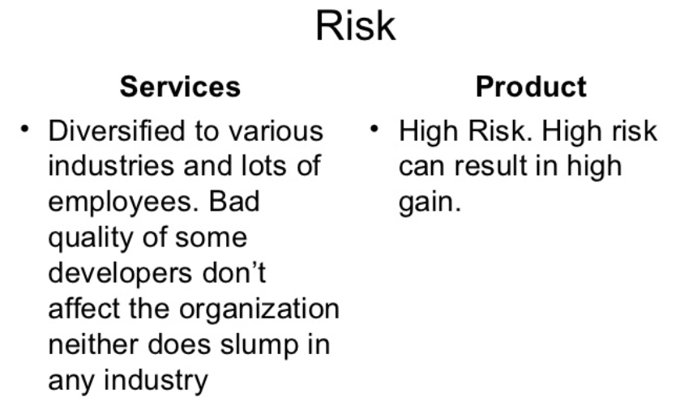

Product Based and Service Based Companies in India
Requirements
PRODUCT
Microsoft, Google, IBM, Amazon, Oracle, CISCO, Adobe, Flipkart, Tally, Druva, Redbus, Zomato, FirstCry, QuickHeal, Paytm, BookMyshow
SERVICE
Capgemini,TCS, Accenture, Infosys, HP, CSC, Wipro, Genpact, Tech Mahindra, Mindtree, Airtel, Reliance
B 2 C
GROWTH
B 2 B

